Slide 1

Metal 3D Printer
1st Prototype Demo
Nathan Krikawa, Nolan Hann

Slide 2

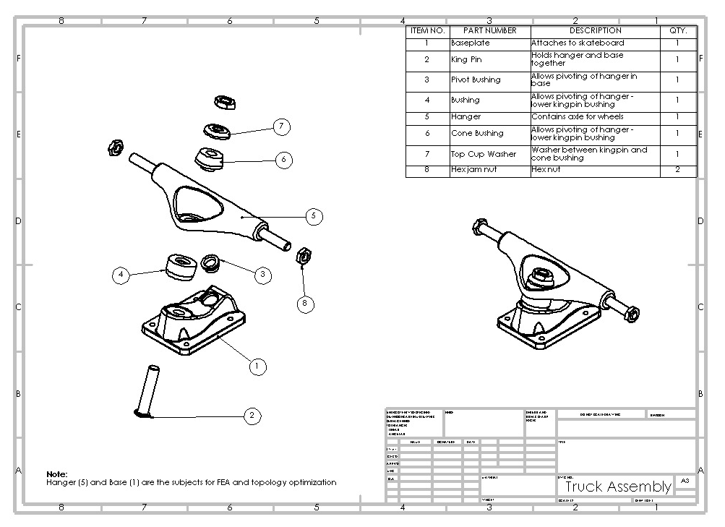
Skateboard Truck
Figure 1: Truck Assembly Drawing
Notes:
Overview:
Installing and Troubleshooting a M100LabR Concept Laser PBF Printer
Printing and evaluating parts and specimens (ie Stress-Strain, Thermal Management)
Creation of a user manual and short curriculum for ME286L
Included is the printer itself, powder mixer, powder trolley, and various powdered alloys for use with the printer
Location of set-up: CEIAS IDEA Lab, Room 116A

Slide 3
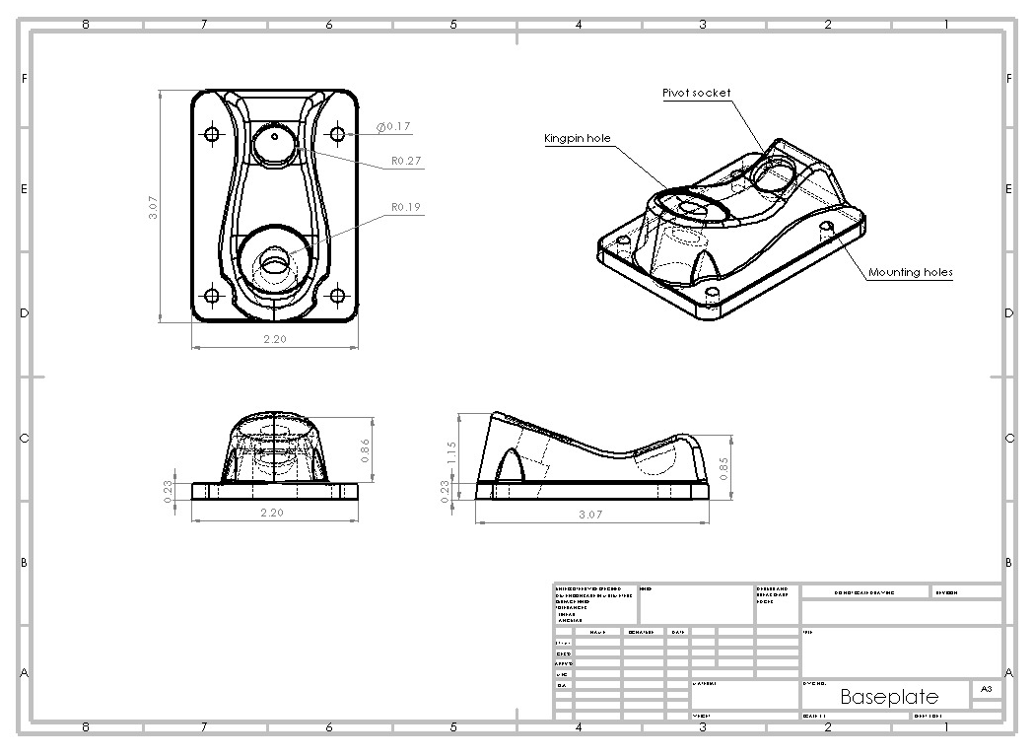
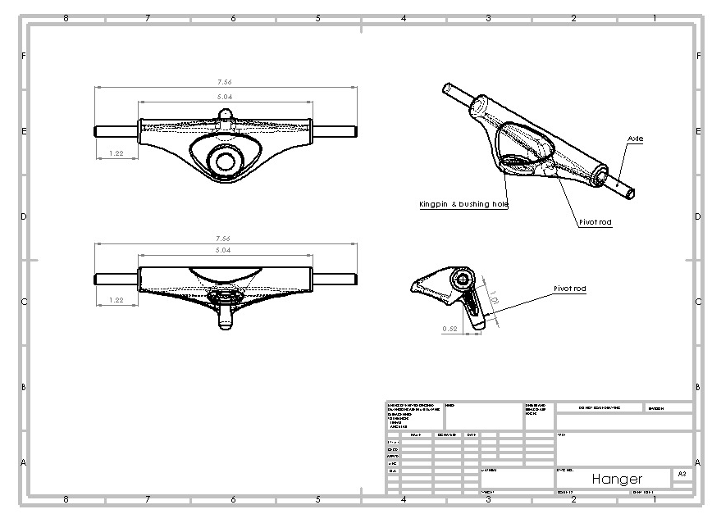
Skateboard Truck
Figure 2: Baseplate Drawing
Figure 2: Hanger Drawing
Notes:
Overview:
Installing and Troubleshooting a M100LabR Concept Laser PBF Printer
Printing and evaluating parts and specimens (ie Stress-Strain, Thermal Management)
Creation of a user manual and short curriculum for ME286L
Included is the printer itself, powder mixer, powder trolley, and various powdered alloys for use with the printer
Location of set-up: CEIAS IDEA Lab, Room 116A

Slide 4
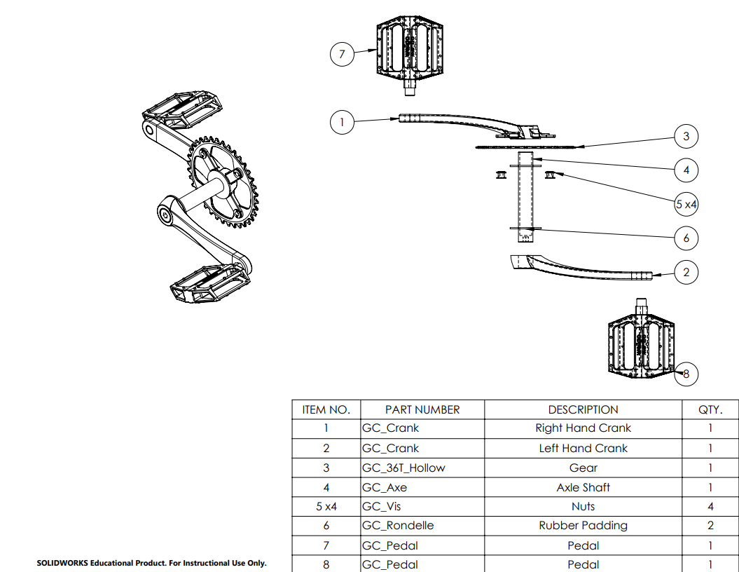
Bike Crank
Figure 4: Pedal Assembly
Notes:
Overview:
Installing and Troubleshooting a M100LabR Concept Laser PBF Printer
Printing and evaluating parts and specimens (ie Stress-Strain, Thermal Management)
Creation of a user manual and short curriculum for ME286L
Included is the printer itself, powder mixer, powder trolley, and various powdered alloys for use with the printer
Location of set-up: CEIAS IDEA Lab, Room 116A

Slide 5
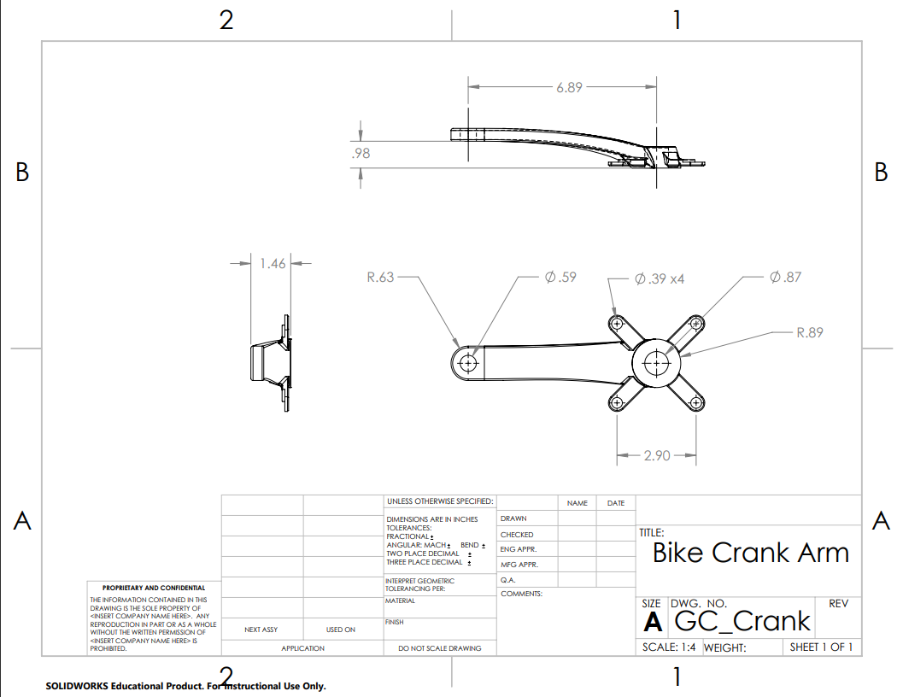
Bike Crank
Figure 5: Crank Arm Drawing
Notes:
Overview:
Installing and Troubleshooting a M100LabR Concept Laser PBF Printer
Printing and evaluating parts and specimens (ie Stress-Strain, Thermal Management)
Creation of a user manual and short curriculum for ME286L
Included is the printer itself, powder mixer, powder trolley, and various powdered alloys for use with the printer
Location of set-up: CEIAS IDEA Lab, Room 116A

Slide 6
Q & A
What question are you trying to answer with the prototype?
  At what scale can we print our models in the metal printer?
Methods/manufacturing process used?
  3D printing plastic, FDM in particular.
What was the answer?
  Skateboard Truck: 40%
  Crank arm: 36%
How did the answer inform design/how do you plan to iterate based on this new info?
  With a good print baseline, we can now focus on tailoring the model positioning to work best for SLM printing (supports, internal geometry), as well as begin on topology optimization.
What team member was responsible for what?
  Nathan: Skateboard Truck
  Nolan: Crank Arm
Notes:
Overview:
Installing and Troubleshooting a M100LabR Concept Laser PBF Printer
Printing and evaluating parts and specimens (ie Stress-Strain, Thermal Management)
Creation of a user manual and short curriculum for ME286L
Included is the printer itself, powder mixer, powder trolley, and various powdered alloys for use with the printer
Location of set-up: CEIAS IDEA Lab, Room 116A

Slide 7

Thank You!
Any Questions?

